Slide 1
Introduction to Quantum Computing
Dr. Edric Matwiejew

Slide 2
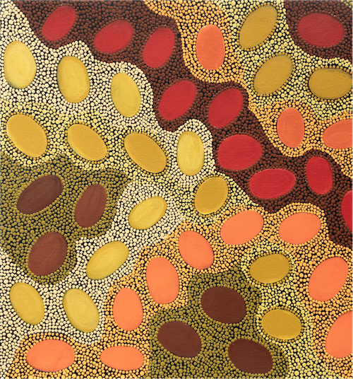


Acknowledgment of Country
Meteorites by Wajarri Yamatji artist Margaret Whitehurst
Ngaala Kaaditji Noongar moort keyen kaadak nidja boodja
Acknowledgment of Country
We acknowledge the traditional owners of land on which Pawsey is located, the Noongar Whadjuk People– their ancestors and elders, past, and present – as the original custodians of this land.
We pay our respects to the traditional owners of the land on which we meet today.

Slide 3
Outline
Introduction to the Pawsey Quantum Supercomputing Innovation Hub
Quantum Computing:
Bits vs qubits, superposition, entanglement
Quantum circuits and quantum gates.
Quantum computing landscape: NISQ devices, analog vs digital
Quantum Algorithms:
Quantum parallelism
Adiabatic quantum computing
Variational quantum circuits (VQCs)
The Quantum approximate optimisation algorithm (QAOA) for combinatorial optimization
Hands-On:
Programming quantum circuits with Qiskit
Solving the max-cut problem with QAOA
Outline

Slide 4
Quantum Computing at Pawsey

Slide 5
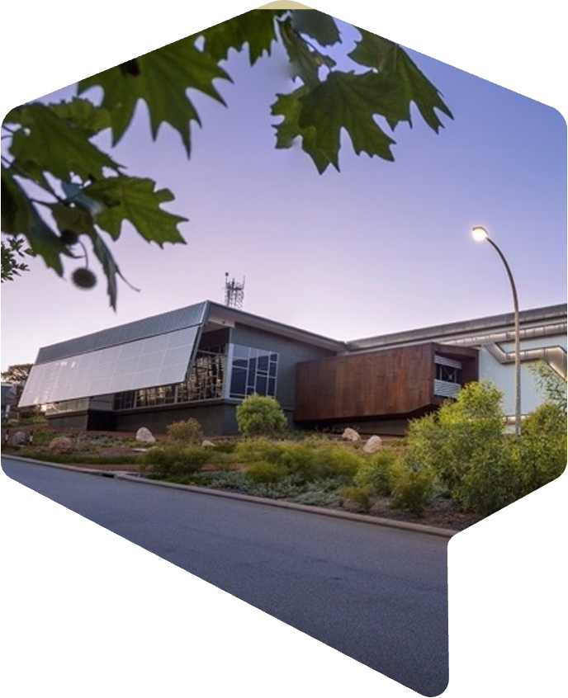

Pawsey Supercomputing Research Centre
National High Performance Computing Centre headquartered in Perth, Western Australia on Whadjuk Noongar country
Launched as Pawsey in 2014, UJV foundations back to 2000
50+ Staff employed via CSIRO, national science agency
AU$70m capital refresh by Australian Government
Houses the fastest Supercomputing in Australia
AU$5m NCRIS investment in developing a Quantum Supercomputing Innovations Hub, part of the National Quantum Strategy
Pawsey strives to be at the cutting-edge of technology. Our domain is scientific computing: accelerating discovery through world-class supercomputing infrastructure and expertise.
Pawsey and Quantum

Slide 6
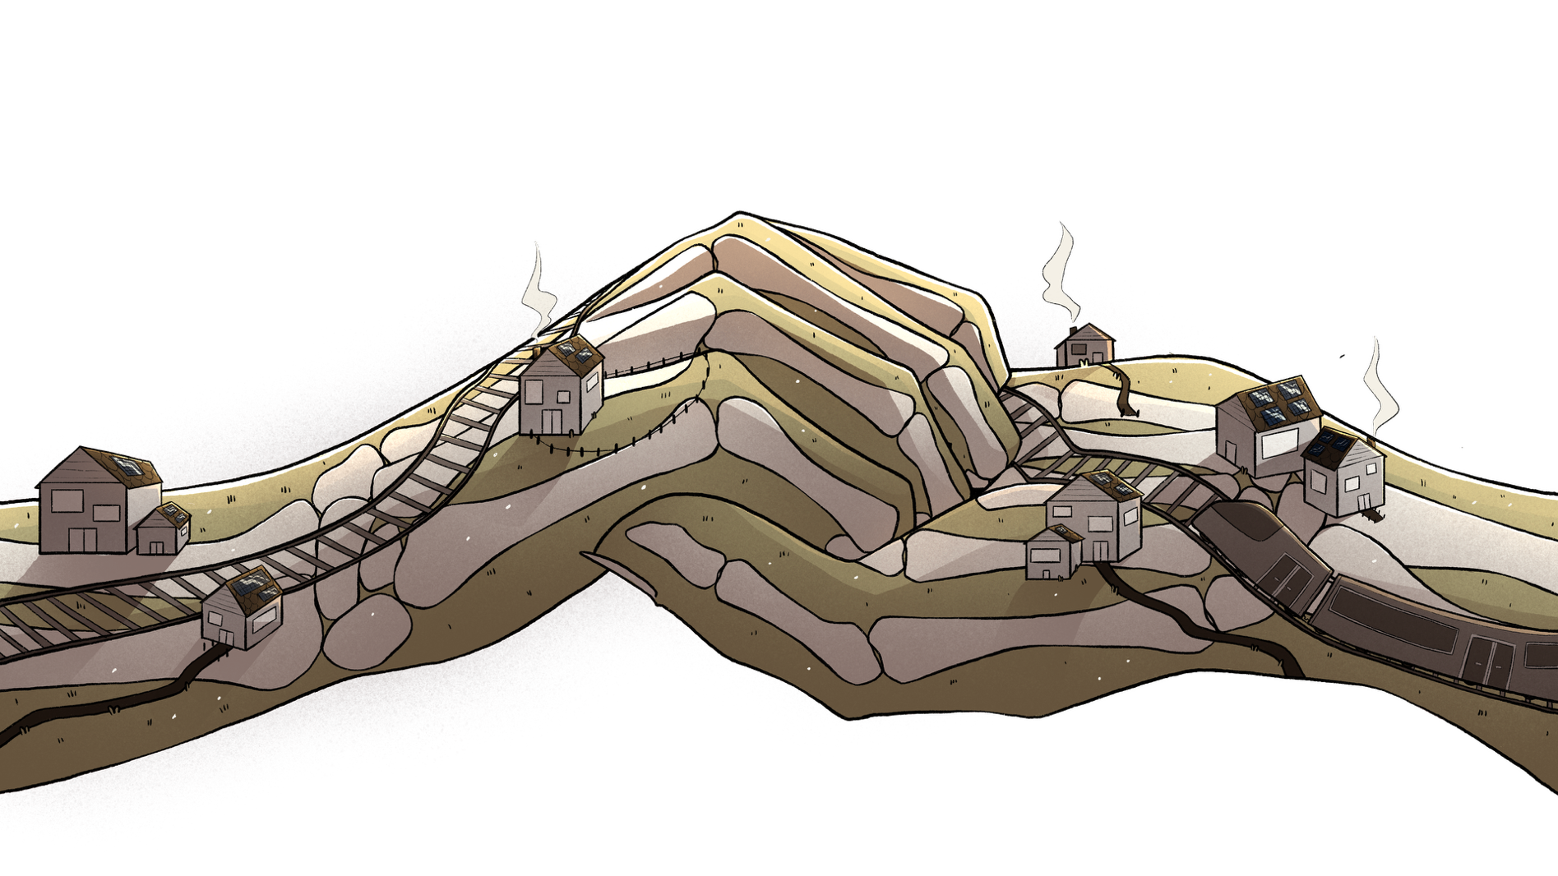
Quantum SUPERcomputing Innovation Hub
Pawsey is on the cutting edge of computing technologies
The Hub, supported by NCRIS funding, a collaborative platform uniting quantum & classical computing to drive scientific breakthroughs.
Empowering researchers to embrace the quantum revolution through education and innovation.
Pawsey and Quantum

Slide 7
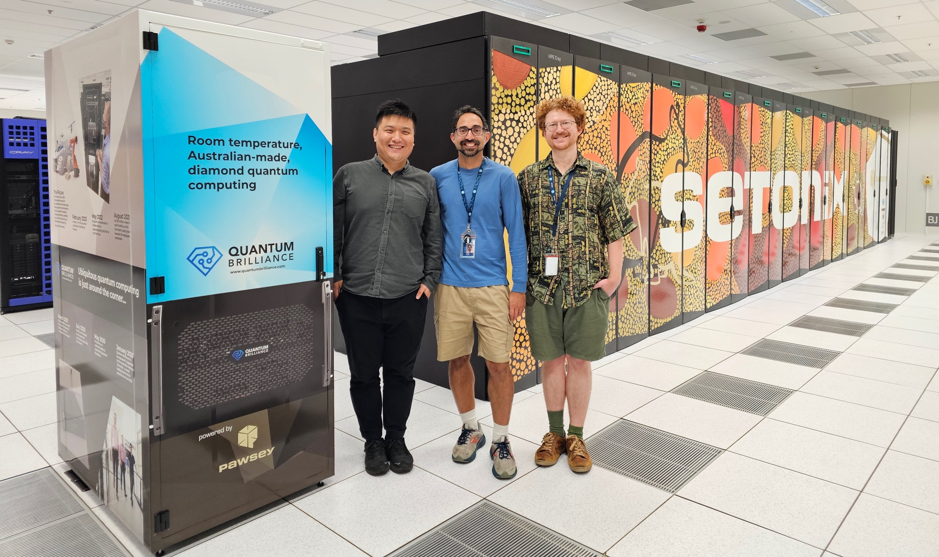
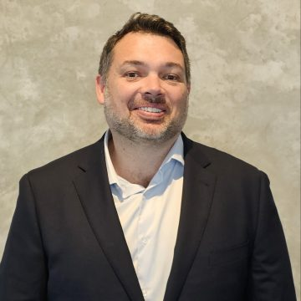
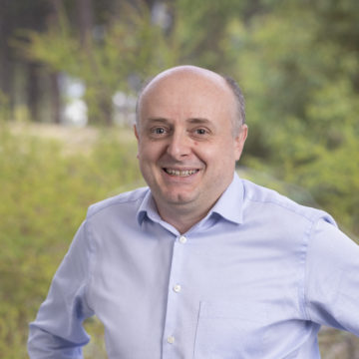
The Team
Pawsey and Quantum

Slide 8
Quantum Computing

Slide 9
Quantum Computing
Computation on information encoded in quantum states – typically qubits.
Leverage quantum phenomena (superposition, interference and entanglement) to solve tough problems faster than classical computers.
Quantum hardware and algorithms differ fundamentally from classical approaches.
Potential for major speedups—though not for every problem.
The challenge of realising practical quantum computing spans physics, mathematics, engineering, and computer science.
No widely adopted high-level languages - programming with quantum “assembly” or “machine-level” instructions (e.g. laser pulse shaping)
Requires rethinking how problems are formulated and tackled, in a rapidly evolving field.
Quantum Computing

Slide 10
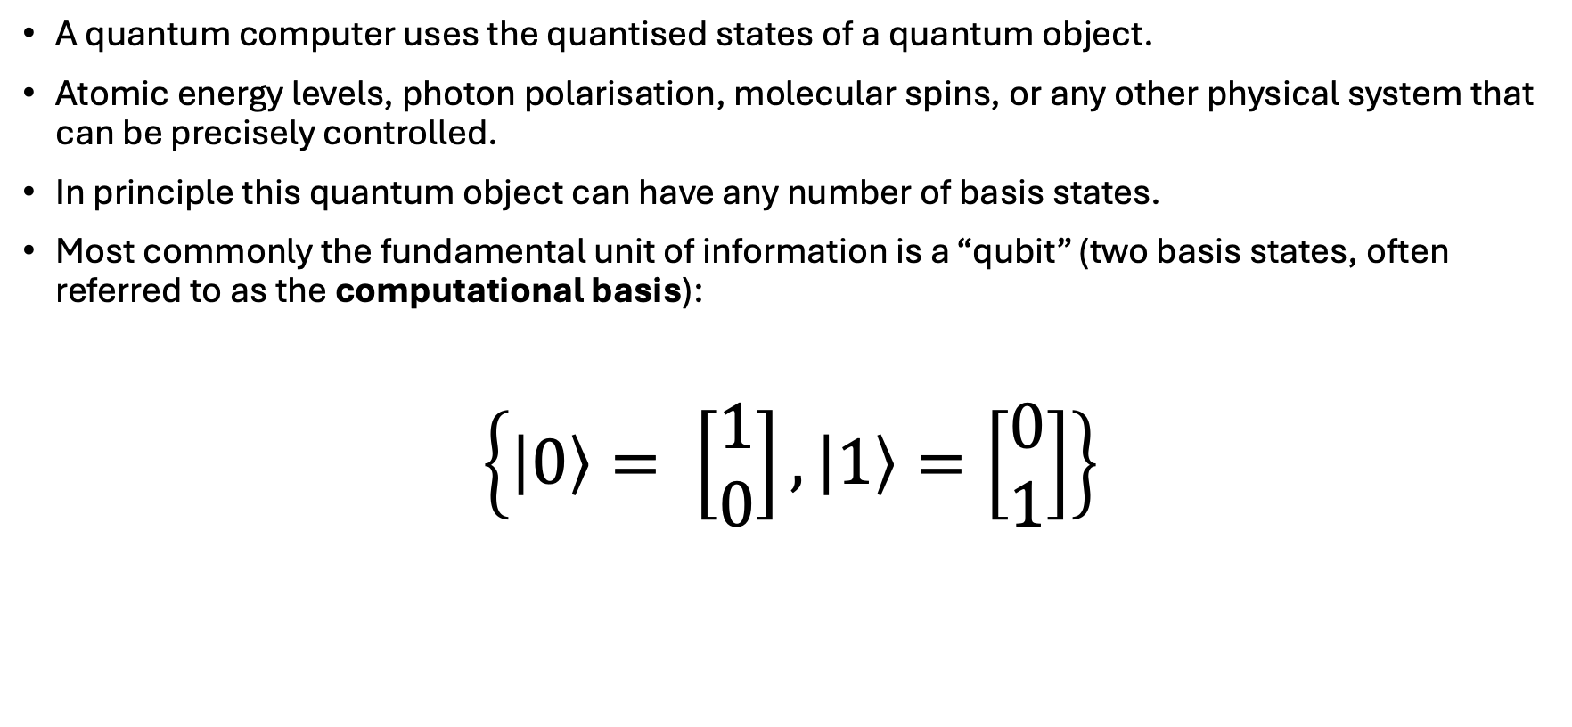
The Computational Basis
A quantum computer uses the quantised states of a quantum object.
Atomic energy levels, photon polarisation, molecular spins, or any other physical system that can be precisely controlled.
In principle this quantum object can have any number of basis states.
Most commonly the fundamental unit of information is a “qubit” (two basis states, often referred to as the computational basis):
$$\left\{\left|0\right\rangle = \left[\begin{matrix}1 \\ 0\end{matrix}\right], \left|1\right\rangle =\left[\begin{matrix}0 \\ 1\end{matrix}\right]\right\}$$
Quantum Computing

Slide 11
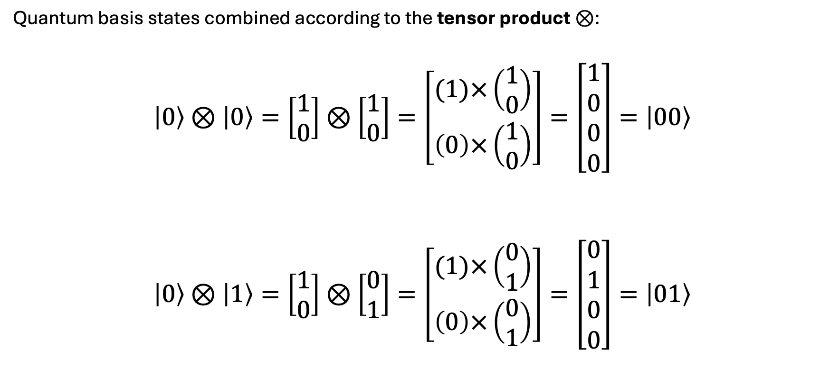
The Computational Basis
Quantum basis states combined according to the tensor product $⊗$:
$$\left|0\right\rangle ⊗\left|0\right\rangle =\left[\begin{matrix}1 \\ 0\end{matrix}\right]⊗\left[\begin{matrix}1 \\ 0\end{matrix}\right]=\left[\begin{matrix}(1)×\left(\begin{matrix}1 \\ 0\end{matrix}\right) \\ \left(0\right)×\left(\begin{matrix}1 \\ 0\end{matrix}\right)\end{matrix}\right]=\left[\begin{aligned}1 \\ 0 \\ 0 \\ 0\end{aligned}\right]=\left|00\right\rangle$$
$$\left|0\right\rangle ⊗\left|1\right\rangle =\left[\begin{matrix}1 \\ 0\end{matrix}\right]⊗\left[\begin{matrix}0 \\ 1\end{matrix}\right]=\left[\begin{matrix}(1)×\left(\begin{matrix}0 \\ 1\end{matrix}\right) \\ \left(0\right)×\left(\begin{matrix}0 \\ 1\end{matrix}\right)\end{matrix}\right]=\left[\begin{aligned}0 \\ 1 \\ 0 \\ 0\end{aligned}\right]=\left|01\right\rangle$$
Quantum Computing

Slide 12
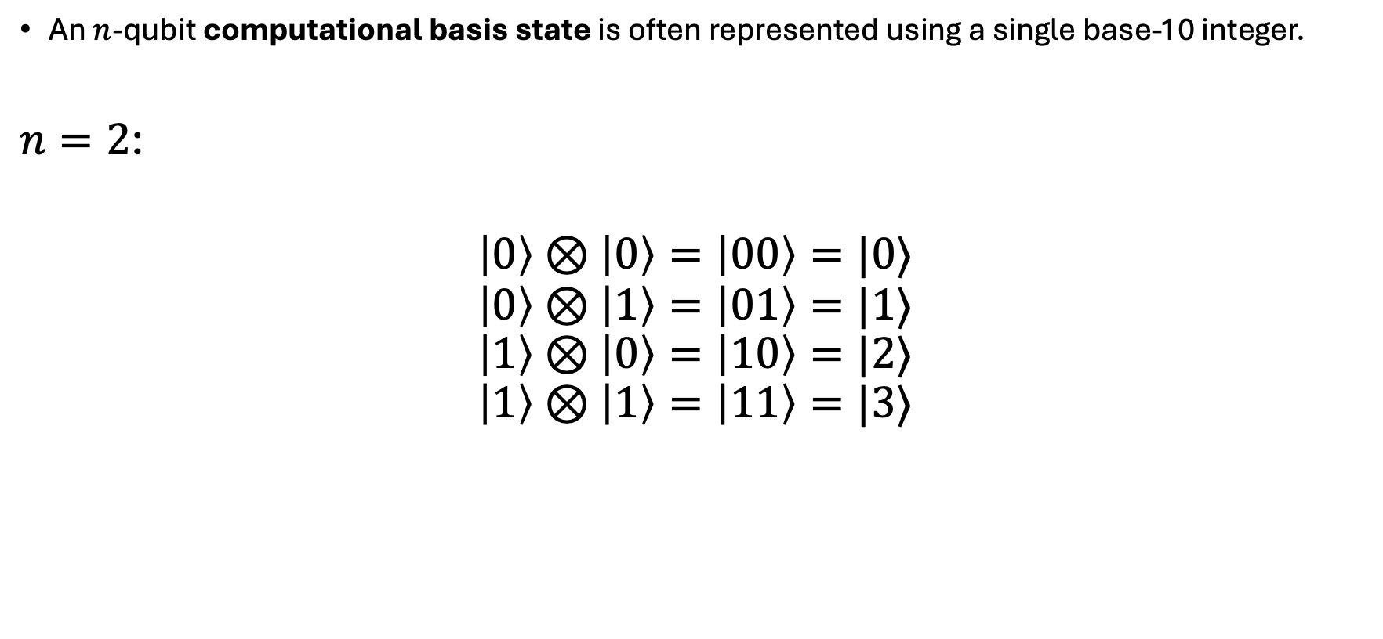
The Computational Basis
An $n$-qubit computational basis state is often represented using a single base-10 integer.
$n=2$:
$$\left|0\right\rangle ⊗\left|0\right\rangle =\left|00\right\rangle =|0⟩$$
$$\left|0\right\rangle ⊗\left|1\right\rangle =\left|01\right\rangle =|1⟩$$
$$\left|1\right\rangle ⊗\left|0\right\rangle =\left|10\right\rangle =|2⟩$$
$$\left|1\right\rangle ⊗\left|1\right\rangle =\left|11\right\rangle =|3⟩$$
Quantum Computing

Slide 13
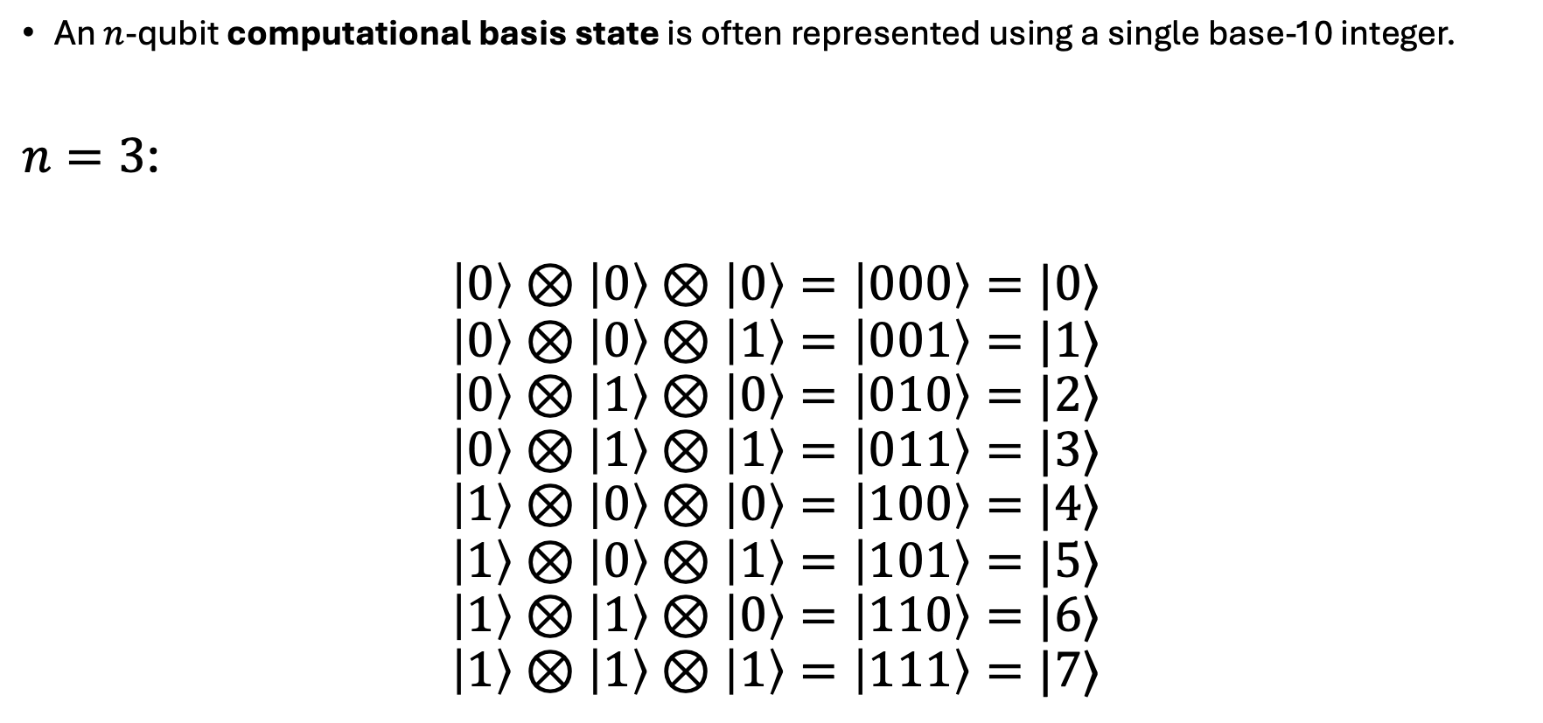
The Computational Basis
An $n$-qubit computational basis state is often represented using a single base-10 integer.
$n=3$:
$$\left|0\right\rangle ⊗\left|0\right\rangle ⊗\left|0\right\rangle =\left|000\right\rangle =|0⟩$$
$$\left|0\right\rangle ⊗\left|0\right\rangle ⊗\left|1\right\rangle =\left|001\right\rangle =|1⟩$$
$$\left|0\right\rangle ⊗\left|1\right\rangle ⊗\left|0\right\rangle =\left|010\right\rangle =|2⟩$$
$$\left|0\right\rangle ⊗\left|1\right\rangle ⊗\left|1\right\rangle =\left|011\right\rangle =|3⟩$$
$$\left|1\right\rangle ⊗\left|0\right\rangle ⊗\left|0\right\rangle =\left|100\right\rangle =|4⟩$$
$$\left|1\right\rangle ⊗\left|0\right\rangle ⊗\left|1\right\rangle =\left|101\right\rangle =|5⟩$$
$$\left|1\right\rangle ⊗\left|1\right\rangle ⊗\left|0\right\rangle =\left|110\right\rangle =|6⟩$$
$$\left|1\right\rangle ⊗\left|1\right\rangle ⊗\left|1\right\rangle =\left|111\right\rangle =|7⟩$$
Quantum Computing

Slide 14
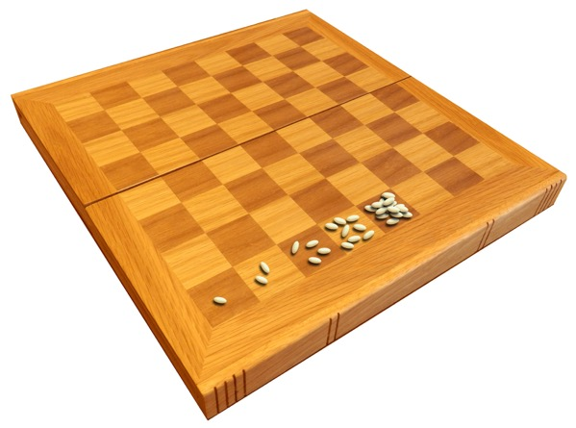

The Computational Basis
Each additional qubit doubles the number of possible states.
For a 2 qubit system$\left|00\right\rangle ,\left|10\right\rangle$, $\left|01\right\rangle$, $\left|11\right\rangle$
Adding one qubit doubles the number of possible possible states.
For a 3 qubit system: $\left|000\right\rangle ,\left|100\right\rangle$, $\left|010\right\rangle$, $\left|001\right\rangle ,\left|101\right\rangle$, $\left|011\right\rangle ,\left|110\right\rangle$, $\left|111\right\rangle$
Consequently, representing a system with $n$ qubits requires on the order of $2^{n}$ classical bits.
Quantum Computing
There’s an ancient story on the origins of chess that shows the power of doubling. Start with 1 grain of rice, then doubled it each time on the next square. What do you need at the end?
The last square needs 18,446,744,073,709,551,615 grains, weighing the same as 2000 billion people!

Slide 15
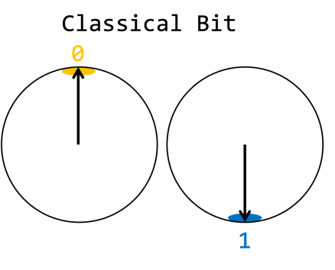
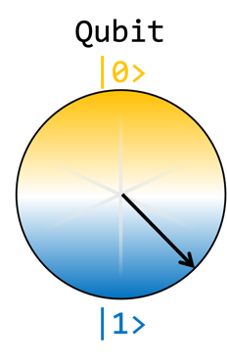
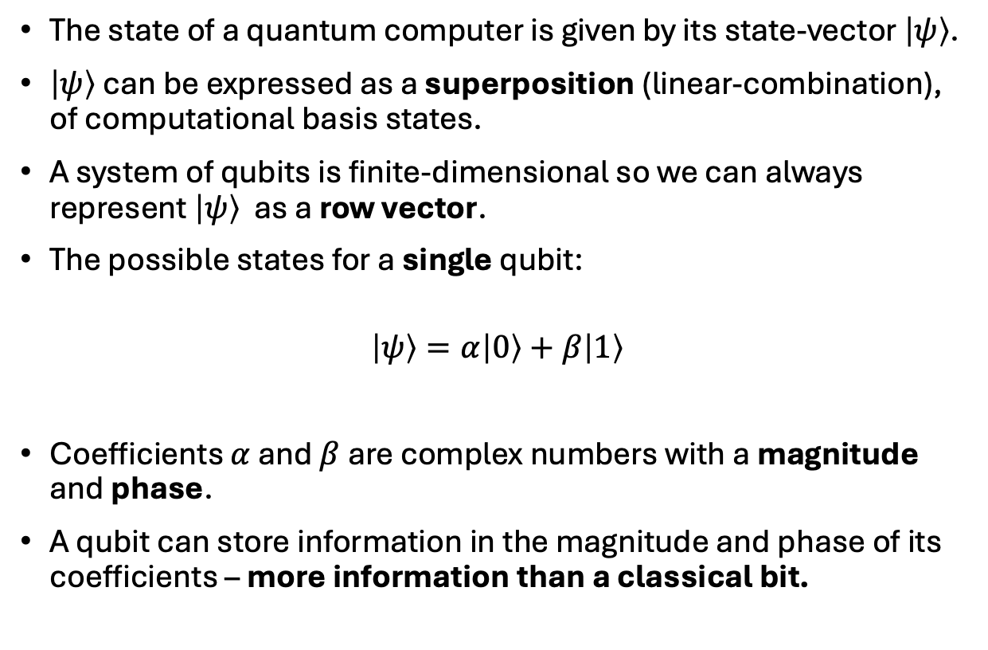
State-Vectors: Superposition
The state of a quantum computer is given by its state-vector $\left|ψ\right\rangle$.
$\left|ψ\right\rangle$can be expressed as a superposition (linear-combination), of computational basis states.
A system of qubits is finite-dimensional so we can always represent $\left|ψ\right\rangle$ as a row vector.
The possible states for a single qubit:
$$\left|ψ\right\rangle =α\left|0\right\rangle +β\left|1\right\rangle$$
Coefficients $α$ and $β$ are complex numbers with a magnitude and phase.
A qubit can store information in the magnitude and phase of its coefficients – more information than a classical bit.
Quantum Computing

Slide 16
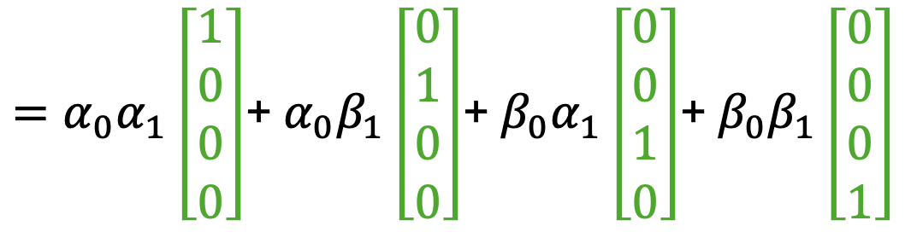

State-Vectors: Superposition
Putting together two qubits: $\left|ψ\right\rangle =\left(α_{0}\left|0\right\rangle +β_{0}|1⟩ \right)⊗\left(α_{1}\left|0\right\rangle +β_{1}\left|1\right\rangle \right)$
$=α_{0}α_{1}\left|00\right\rangle +α_{0}β_{1}\left|01\right\rangle +β_{0}α_{1}\left|10\right\rangle +β_{0}β_{1}|11⟩$
Quantum Computing
$=α_{0}α_{1}\left[\begin{aligned}1 \\ 0 \\ 0 \\ 0\end{aligned}\right]$+ $α_{0}β_{1}\left[\begin{aligned}0 \\ 1 \\ 0 \\ 0\end{aligned}\right]$+ $β_{0}α_{1}\left[\begin{aligned}0 \\ 0 \\ 1 \\ 0\end{aligned}\right]$+ $β_{0}β_{1}\left[\begin{aligned}0 \\ 0 \\ 0 \\ 1\end{aligned}\right]$
Superposition

Slide 17

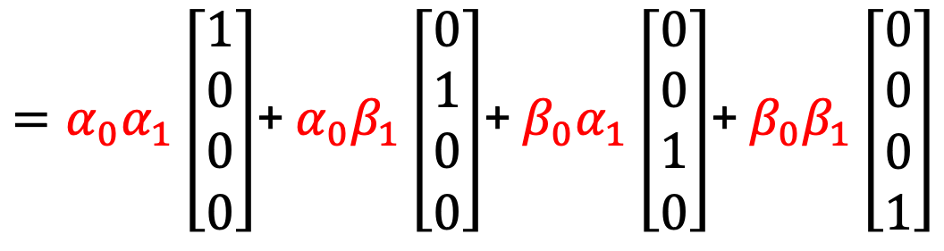
State-Vectors: Interference
Differences in the complex phase of $α_{i}$ and $β_{i}$ cause constructive or destructive interference, altering the magnitude of basis state in the superposition. $\left|ψ\right\rangle =\left(α_{0}\left|0\right\rangle +β_{0}|1⟩ \right)⊗\left(α_{1}\left|0\right\rangle +β_{1}\left|1\right\rangle \right)$
$=α_{0}α_{1}\left|00\right\rangle +α_{0}β_{1}\left|01\right\rangle +β_{0}α_{1}\left|10\right\rangle +β_{0}β_{1}|11⟩$
Quantum Computing
$=α_{0}α_{1}\left[\begin{aligned}1 \\ 0 \\ 0 \\ 0\end{aligned}\right]$+ $α_{0}β_{1}\left[\begin{aligned}0 \\ 1 \\ 0 \\ 0\end{aligned}\right]$+ $β_{0}α_{1}\left[\begin{aligned}0 \\ 0 \\ 1 \\ 0\end{aligned}\right]$+ $β_{0}β_{1}\left[\begin{aligned}0 \\ 0 \\ 0 \\ 1\end{aligned}\right]$
Interference
Notes:
Add plot showing effects of phase.

Slide 18

State-Vectors: Measurement
Quantum computing relies on quantum superposition—a single quantum object can occupy multiple states simultaneously.
This phenomenon has been extensively experimentally confirmed.
Equally well-established is the phenomenon of collapse.
When $\left|ψ\right\rangle$is measured, it collapses into ONE of its basis states.
Quantum Computing

Slide 19
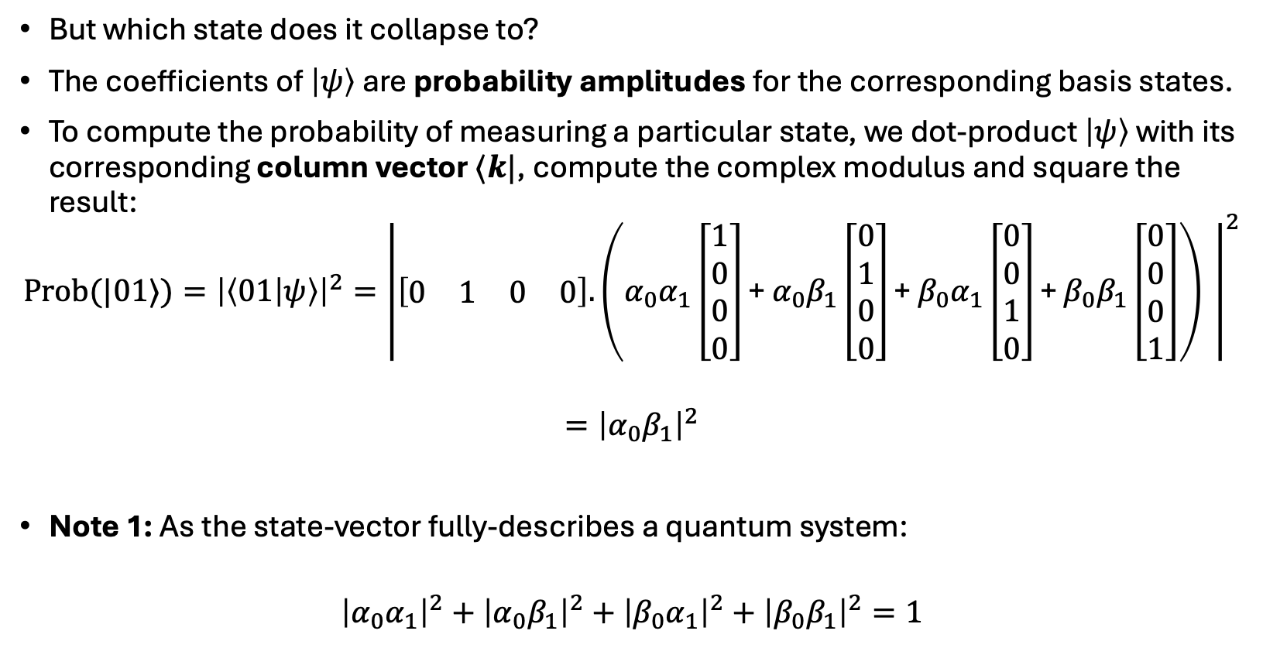
State-Vectors: Measurement
But which state does it collapse to?
The coefficients of $\left|ψ\right\rangle$are probability amplitudes for the corresponding basis states.
To compute the probability of measuring a particular state, we dot-product $\left|ψ\right\rangle$ with its corresponding column vector $⟨k|$, compute the complex modulus and square the result:
$${{\text{Prob}(|01⟩)=\left|\left\langle 01 | ψ\right\rangle \right|}^{2}=\left|\left[\begin{matrix}0 & 1 & 0 & 0\end{matrix}\right].\left(α_{0}α_{1}\left[\begin{aligned}1 \\ 0 \\ 0 \\ 0\end{aligned}\right]\text{+} α_{0}β_{1}\left[\begin{aligned}0 \\ 1 \\ 0 \\ 0\end{aligned}\right]\text{+} β_{0}α_{1}\left[\begin{aligned}0 \\ 0 \\ 1 \\ 0\end{aligned}\right]\text{+} β_{0}β_{1}\left[\begin{aligned}0 \\ 0 \\ 0 \\ 1\end{aligned}\right]\right) \right|}^{2}$$
$$={\left|α_{0}β_{1}\right|}^{2}$$
Note 1: As the state-vector fully-describes a quantum system:
$${\left|α_{0}α_{1}\right|}^{2}+{\left|α_{0}β_{1}\right|}^{2}+{\left|β_{0}α_{1}\right|}^{2}+{\left|β_{0}β_{1}\right|}^{2}=1$$
Quantum Computing

Slide 20
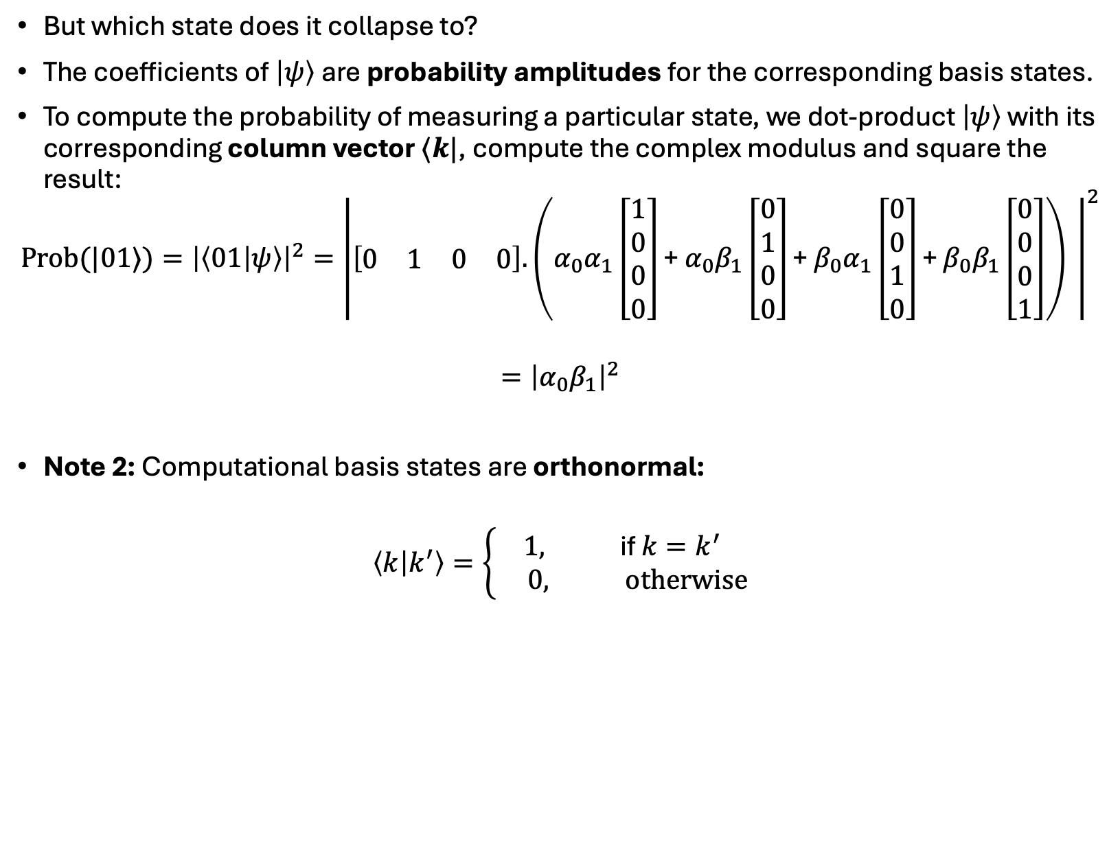
State-Vectors: Measurement
But which state does it collapse to?
The coefficients of $\left|ψ\right\rangle$are probability amplitudes for the corresponding basis states.
To compute the probability of measuring a particular state, we dot-product $\left|ψ\right\rangle$ with its corresponding column vector $⟨k|$, compute the complex modulus and square the result:
$${{\text{Prob}(|01⟩)=\left|\left\langle 01 | ψ\right\rangle \right|}^{2}=\left|\left[\begin{matrix}0 & 1 & 0 & 0\end{matrix}\right].\left(α_{0}α_{1}\left[\begin{aligned}1 \\ 0 \\ 0 \\ 0\end{aligned}\right]\text{+} α_{0}β_{1}\left[\begin{aligned}0 \\ 1 \\ 0 \\ 0\end{aligned}\right]\text{+} β_{0}α_{1}\left[\begin{aligned}0 \\ 0 \\ 1 \\ 0\end{aligned}\right]\text{+} β_{0}β_{1}\left[\begin{aligned}0 \\ 0 \\ 0 \\ 1\end{aligned}\right]\right) \right|}^{2}$$
$$={\left|α_{0}β_{1}\right|}^{2}$$
Note 2: Computational basis states are orthonormal:
$$\left\langle k | k^{′}\right\rangle =\left\{\begin{matrix}1, \text{if} k=k^{′} \\ 0, \text{otherwise}\end{matrix}\right.$$
Quantum Computing

Slide 21
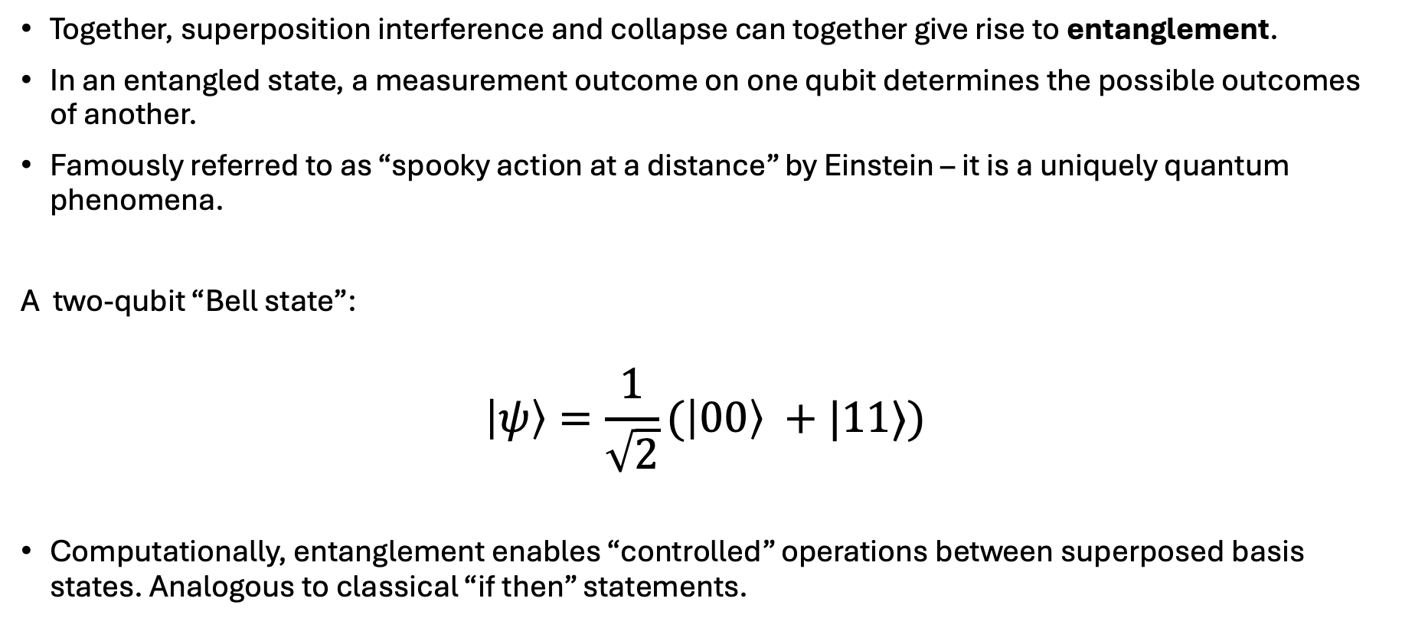
State-Vectors: Entanglement
Together, superposition interference and collapse can together give rise to entanglement.
In an entangled state, a measurement outcome on one qubit determines the possible outcomes of another.
Famously referred to as “spooky action at a distance” by Einstein – it is a uniquely quantum phenomena.
A two-qubit “Bell state”:
$$\left|ψ\right\rangle =\frac{1}{\sqrt{2}}(\left|00\right\rangle +|11⟩)$$
Computationally, entanglement enables “controlled” operations between superposed basis states. Analogous to classical “if then” statements.
Quantum Computing

Slide 22
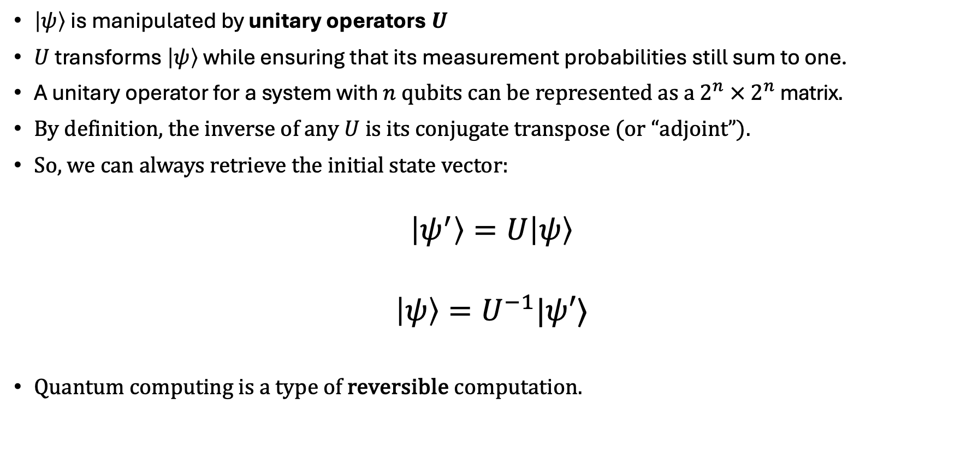
Unitaries and Quantum Circuits
$\left|ψ\right\rangle$ is manipulated by unitary operators $U$
$U$ transforms $\left|ψ\right\rangle$ while ensuring that its measurement probabilities still sum to one.
A unitary operator for a system with $n$ qubits can be represented as a $2^{n} × 2^{n}$ matrix.
By definition, the inverse of any $U$ is its conjugate transpose (or “adjoint”).
So, we can always retrieve the initial state vector:
$$\left|ψ^{′}\right\rangle =U\left|ψ\right\rangle$$
$$\left|ψ\right\rangle =U^{−1}|ψ′⟩$$
Quantum computing is a type of reversible computation.
Quantum Computing

Slide 23

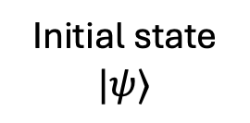
Quantum Circuits
Quantum circuits are a diagrammatic representation of a quantum program.
They show how unitaries are applied to “registers” of qubits and where measurement occurs.
Quantum Computing
$${I⊗U}_{0}⊗I⊗I$$
Output
(Measurement)
Initial state
$$|ψ⟩$$
Controlled
Operation

Slide 24

Quantum Computing Models: Analogue
Continuously manipulates quantum states through engineered interactions between particles (e.g. atoms or ions). Viewed as applying a time-dependant unitary to prepare a target state:
$$U\left(t\right)\left|ψ\right\rangle =|ψ^{′}⟩$$
Relies on the physical characteristics of the system and is less flexible for general-purpose computation.
Applications include optimisation, graph-based problems and reservoir computing.
Quantum Computing

Slide 25
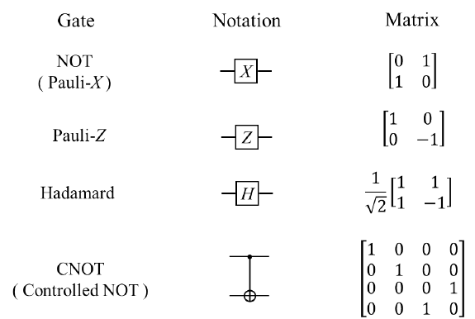

Quantum Computing Models: Digital
Uses discrete quantum gates - analogous to classically logic gates. Viewed a sequence of unitaries, called quantum “gates”, that act on one or more qubits:
$${U_{2}U}_{1}U_{0}\left|ψ\right\rangle =\left|ψ^{′}\right\rangle$$
Digital systems are more versatile and are the foundation for universal quantum computers.
More dependant on error mitigation or correction.
Quantum Computing

Slide 26
Quantum Computing Models: Digital
Quantum Computing

Slide 27
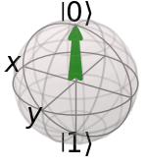
Quantum Computing Models: Digital
Quantum Computing

Slide 28
Quantum Computing Models: Digital
Quantum Computing

Slide 29
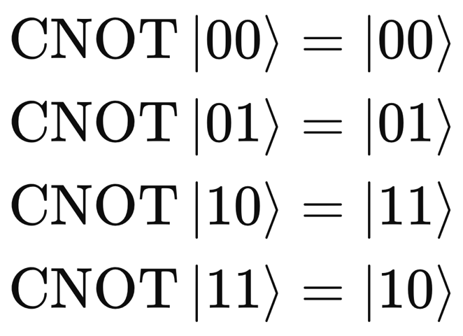
Quantum Computing Models: Digital
Quantum Computing
Control
Target

Slide 30
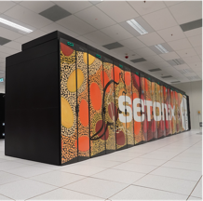
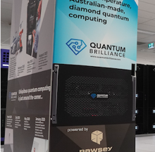
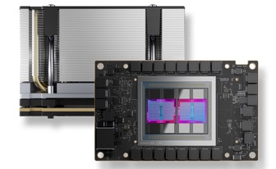
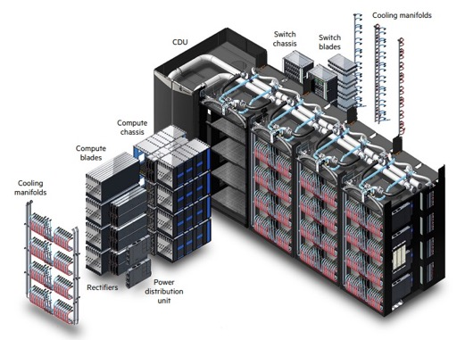
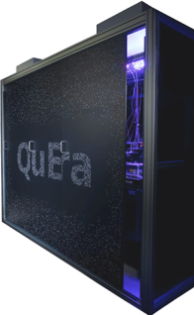
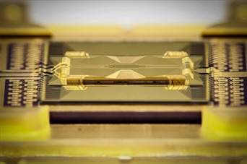
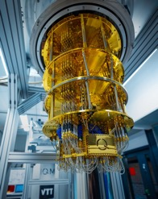
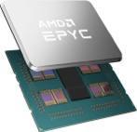
Classical
computers
Quantum
computers
VS
Stores bits to represent data, applies bit manipulation to represent operations
Really fast (GHz)
Good at arithmetic, 2 + 2 = 4 (almost) always
Production scale, with systems relying on silicon transistors.
Some variety in hardware but all pretty similar.
Operates on “qubits”
Not good at arithmetic BUT (much) better at other problems.
We are in Noisy Intermediate Scale Quantum (NISQ) Era.
Current technologies are all noisy (90-99% fidelity on single gate operations).
Low qubit counts (100)
Quite slow (100 circuits per second)
Lots of variety in technologies, all single experiments
Computing Comparison

Slide 31
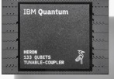
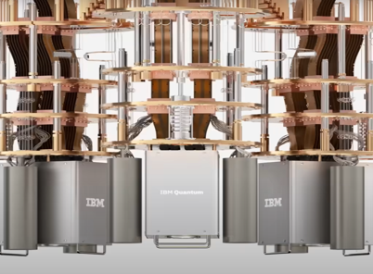
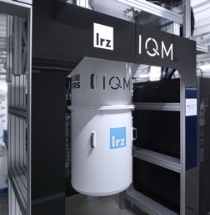


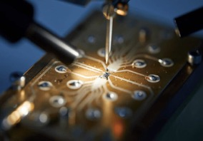
Quantum Computing Hardware
Analogue
Superconducting Flux Qubits: D-Wave Systems
Needs Helium 3 cooling
Neutral Atoms: QuEra Computing, Pasqal, Infleqtion
Needs vacuum chamber, lasers
Quantum Computing
20-50 qubits
130-150 qubits
36 qubits
256 qubits, analog computer
few qubits

Slide 32
Quantum Computing Hardware
Digital
Superconducting Qubits: IQM, IBM, Google Quantum AI, Rigetti Computing
Needs Helium 3 cooling
Trapped Ions: IonQ, Quantinuum
Needs vacuum chamber, magnetic traps, lasers
Neutral Atoms: QuEra Computing, Pasqal, Infleqtion
Needs vacuum chamber, magnetic traps, lasers
Silicon Spin Qubits: Silicon Quantum Computing (SQC), Diraq
Needs Helium 3 cooling
Quantum Computing
20-50 qubits
130-150 qubits
36 qubits
256 qubits, analog computer
few qubits

Slide 33
Quantum Computing Hardware
Digital (cont.)
Diamond-Based Qubits: Quantum Brilliance
Currently limited scaling
Photonic Qubits: ORCA, Xanadu
Silicon Photonic Qubits: PsiQuantum
Needs Helium 3 cooling
Quantum Computing
20-50 qubits
130-150 qubits
36 qubits
256 qubits, analog computer
few qubits

Slide 34
Quantum Algorithms

Slide 35
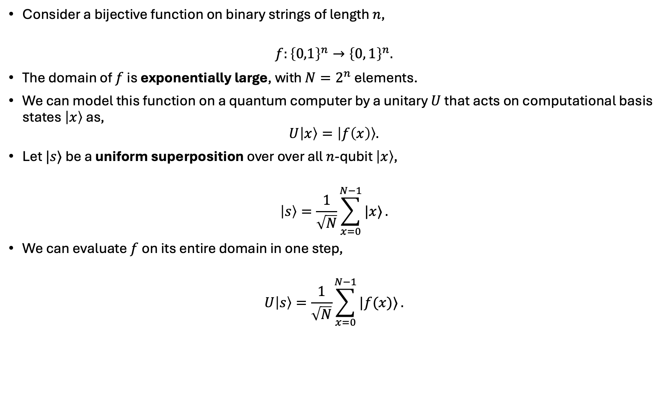
Quantum Parallelism
Consider a bijective function on binary strings of length $n$,
$$f:{\left\{0,1\right\}}^{n}→{\left\{0, 1\right\}}^{n}.$$
The domain of $f$ is exponentially large, with $N=2^{n}$ elements.
We can model this function on a quantum computer by a unitary $U$ that acts on computational basis states $\left|x\right\rangle$ as,
$$U\left|x\right\rangle =\left|f\left(x\right)\right\rangle .$$
Let $|s⟩$ be a uniform superposition over over all $n$-qubit $\left|x\right\rangle$,
$$\left|s\right\rangle =\frac{1}{\sqrt{N}}\sum_{x=0}^{N−1}{|x⟩}.$$
We can evaluate $f$ on its entire domain in one step,
$$U\left|s\right\rangle =\frac{1}{\sqrt{N}}\sum_{x=0}^{N−1}{|f(x)⟩}.$$
Quantum Algorithms

Slide 36
Quantum Parallelism
Quantum parallelism through quantum superposition underpins the potential for quantum algorithms to provide a speedup over classical methods.
Quantum Algorithms

Slide 37
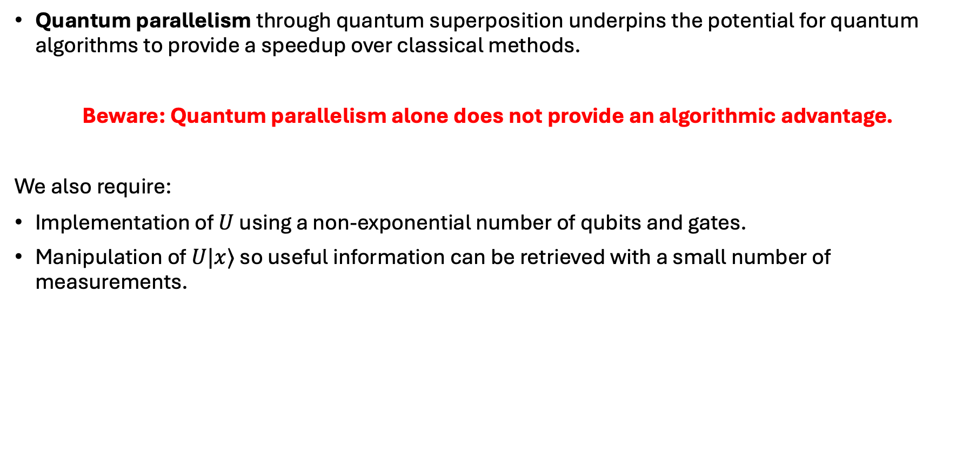
Quantum Parallelism
Quantum parallelism through quantum superposition underpins the potential for quantum algorithms to provide a speedup over classical methods.
Beware: Quantum parallelism alone does not provide an algorithmic advantage.
We also require:
Implementation of $U$ using a non-exponential number of qubits and gates.
Manipulation of $U|x⟩$ so useful information can be retrieved with a small number of measurements.
Quantum Algorithms

Slide 38
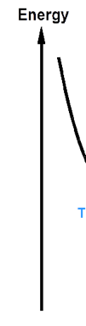
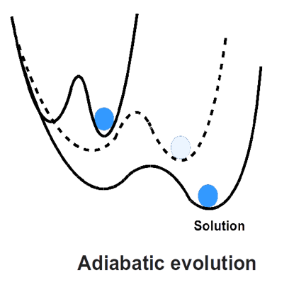
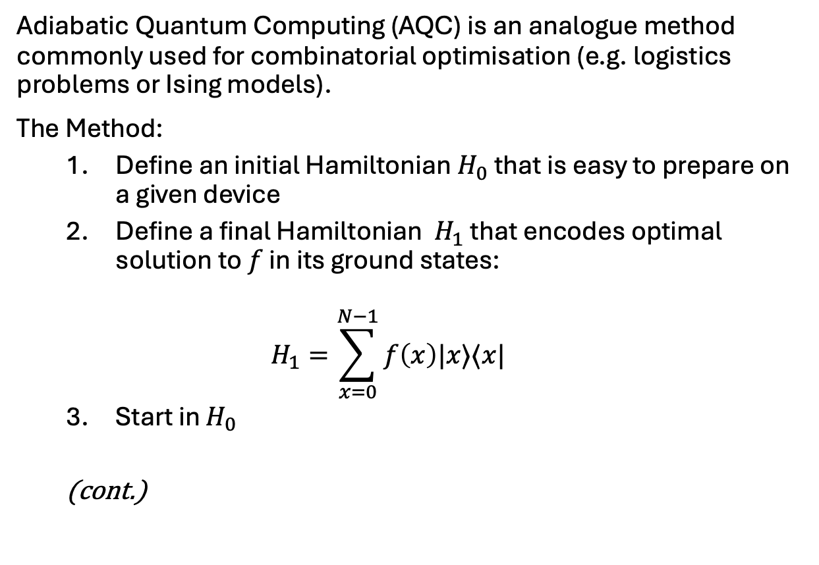
Adiabatic Quantum Computing
Adiabatic Quantum Computing (AQC) is an analogue method commonly used for combinatorial optimisation (e.g. logistics problems or Ising models).
The Method:
Define an initial Hamiltonian $H_{0}$ that is easy to prepare on a given device
Define a final Hamiltonian $H_{1}$ that encodes optimal solution to $f$ in its ground states:
$$H_{1}=\sum_{x=0}^{N−1}{f\left(x\right)|x⟩⟨x|}$$
Start in $H_{0}$
(cont.)
Quantum Algorithms
Notes:
Image taken from: https://medium.com/@quantum_wa/quantum-annealing-cdb129e96601

Slide 39
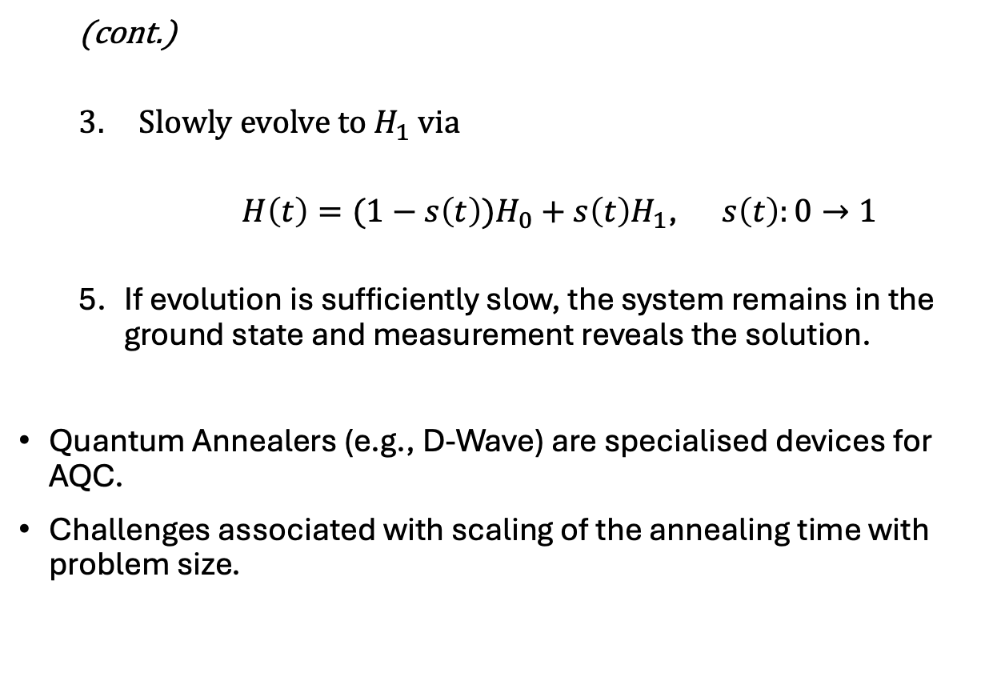
Adiabatic Quantum Computing
(cont.)
Slowly evolve to $H_{1}$ via
$H\left(t\right)=(1−s\left(t\right){)H}_{0}+s\left(t\right)H_{1}$, $s\left(t\right):0→1$
If evolution is sufficiently slow, the system remains in the ground state and measurement reveals the solution.
Quantum Annealers (e.g., D-Wave) are specialised devices for AQC.
Challenges associated with scaling of the annealing time with problem size.
Quantum Algorithms
Notes:
Image taken from: https://medium.com/@quantum_wa/quantum-annealing-cdb129e96601

Slide 40
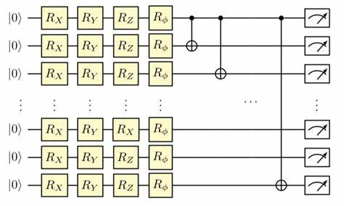
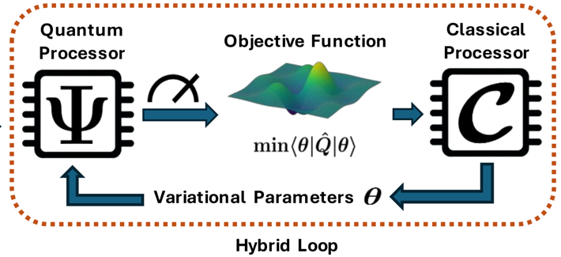
Variational Quantum Circuits
Quantum circuit with adjustable parameters (e.g. angles in rotation gates).
Built up in layers, the depth of the circuit is adjusted to match problem complexity and hardware constraints.
Measurement and feedback loop:
Quantum circuit prepares a state
Measure to compute an objective function
A classical optimiser updates parameters
Repeat until convergence.
Algorithms for combinatorial optimisation, eigenvalue solving and machine learning fall within this model.
These are a form of hybrid quantum-classical computation.

Slide 41


The Max-Cut Problem
Problem Statement:
For a given graph, find an assignment of vertices to two set such that the number of adjacent vertices in different sets is maximised.
Why do we care?
A simple to state problem that is computationally hard (NP-hard).
Other difficult optimisation problems can be framed as a max-cut problem: electrical circuit layouts, spin models, portfolio optimisation…
Straight-forward to problem express on a quantum computer.
2
1
4
3
0
$$z=10110$$
$$\left|z\right\rangle =\left|10110\right\rangle$$

Slide 42

The Quantum Approximate Optimisation Algorithm
The Quantum Approximate Optimisation Algorithm (QAOA) aims to find optimal or near-optimal solutions to combinatorial optimisation problems (like MaxCut).
A binary representation of the problem solutions are mapped to the basis states of qubits.
A variational quantum circuit “ansatz” prepares a state where the probability of measuring low-cost (or high-quality) solutions are amplified.

Slide 43

The Quantum Approximate Optimisation Algorithm
The quantum circuit of the QAOA has three main components.
The first is preparation of a uniform superposition over all possible states.
This is easily done a quantum computer by applying a “Hadamard” (H) gate to each qubit.
$$H\left|0\right\rangle →\frac{1}{\sqrt{2}}\left(\left|0\right\rangle +\left|1\right\rangle \right)$$

Slide 44


The Quantum Approximate Optimisation Algorithm
The quantum circuit of the QAOA has three main components.
First: preparation of a uniform superposition over all possible states.
Second: a phase-shift unitary rotations the phase of each state proportionally to its assigned cost.
For the max-cut problem the rotation angle is
$$γ C(z)$$
$γ$ is a variational parameter and $C\left(z\right)$is the value of the cut for solution $z$.

Slide 45


The Quantum Approximate Optimisation Algorithm
Third: a mixing-unitary drives the transfer of amplitude between basis states.
This is typically achieved by applying an X-rotation to each qubit for angle $β$, where $β$ is another variational parameter.
During this step, the phase-encoded solution costs cause destructive and constructive interference.

Slide 46


The Quantum Approximate Optimisation Algorithm
In the third stage a mixing-unitary drives the transfer of amplitude between basis states.
This is typically achieved by applying an x-rotation to each qubit for angle $β$, where $β$ is another variational parameter.
During this step, the phase-encoded solution costs cause destructive and constructive interference.
The phase-shift and mixing unity are applied for $p$ iterations. As $p$ increases, so does the degree of possible interference.

Slide 47


The Quantum Approximate Optimisation Algorithm
The full set of variational parameters is:
$$γ=\left(γ_{1},…γ_{p}\right)$$
$$β=\left(β_{1},…β_{p}\right)$$
These are tuned by a classical optimiser whose objective function is the average measured (expectation value) of the solution cost.
As the objective function increase, so does the probability of measure an optimal, or near-optimal, solution.

Slide 48
Conclusion
Quantum computing is progressing rapidly, but remains in its early stages.
Current efforts focus on near-term systems: how to construct and use them effectively.
Computing is a broad, collaborative field—quantum computing is no different, drawing on physics, math, engineering, and beyond.
You can get involved: domain-specific applications (beyond physics) are driving interest, while tools from theoretical physics are increasingly being repurposed for new algorithmic insights.
Conclusion

Slide 49
Conclusion
Quantum computing is progressing rapidly, but remains in its early stages.
Current efforts focus on near-term systems: how to construct and use them effectively.
Computing is a broad, collaborative field—quantum computing is no different, drawing on physics, math, engineering, and beyond.
You can get involved: domain-specific applications (beyond physics) are driving interest, while tools from theoretical physics are increasingly being repurposed for new algorithmic insights.
Conclusion

Slide 50
Workshop Activity: Hands-On Quantum Computing
https://github.com/PawseySC/PHYS4004_quantum_computing

